Slide 1
“What Does the Color You Choose Say about You?” Discussion Questions
Discuss these questions in your small groups please.
What color did you choose and WHY did you pick that color?
Does the description of the color accurately describe you, why or why not?
Whole Group Discussion Question
How relevant and reliable do you think this activity is, and WHY do you think that?
Notes:
Day 1, activity 1 small group discussion questions.

Slide 2
Personality Traits Suggestion List
Positive traits: passionate, action orientated, determined, optimistic, cheerful, go getter, social, trustworthy, dependable, reliable, loyal, compassionate, intelligent, peaceful, down-to-earth, creative, driven, goal orientated, balanced, nurturing…
Negative traits: immature, demanding, pessimistic, controlling, untrustworthy, dishonest, manipulative, angry, materialistic, mean-spirited, indecisive, unemotional, impractical, impatient, negative, cold…
Notes:
Day 1 activity 2 when students are filling in their t-chart regarding their positive and negative personality traits.

Slide 3
“Understanding the Meaning of Colors in Color Psychology” Whole Group Discussion Questions
How accurate were your top 4 favorite colors in describing who you are?
Did you learn anything new about yourself or realize things about yourself after doing this activity?
Why do you think your t-chart had you list positive and negative traits about yourself?
Can we improve things which we do not like about ourselves?
How do we change things about ourselves?
Notes:
Day 1 Activity 2 whole group discussion questions

Slide 4
OWN IT! Setting S.M.A.R.T. Goals
What is a S.M.A.R.T. goal? This is way to format your goals which will help you be successful in accomplishing what you want to achieve in life, school, and with personal growth. This is what S.M.A.R.T. stands for…please record in your interactive notebooks.
Specific (simple, sensible, significant).
Measurable (meaningful, motivating).
Achievable (attainable).
Relevant (reasonable, results-based).
Time bound (time-based, time limited, time-sensitive).
Notes:
Day 2 Activity 3. Have students record SMART acronym in their interactive notebooks on the left-hand page, title the left and right-hand pages “OWN IT! S.M.A.R.T. Goals.” Source: https://www.mindtools.com/pages/article/smart-goals.htm.

Slide 5
OWN IT! Setting S.M.A.R.T. Goals
1. Specific
When creating your goal, try to answer the five "W" questions:
What do I want to accomplish?
Why is this goal important?
Who is involved?
Where is it located?
Which resources or limits are involved?
2. Measurable
It's important to have measurable goals, so that you can track your progress and stay motivated. Ask yourself these questions when writing your goal:
How will I know when it is accomplished?
How much?
How many?
Notes:
Day 2 Activity 3. Have students record notes on the left-hand page of their interactive notebooks.

Slide 6
OWN IT! Setting S.M.A.R.T. Goals
3. Achievable
Your goal also needs to be realistic and attainable to be successful. An achievable goal will usually answer questions such as:
How can I accomplish this goal?
How realistic is the goal?
4. Relevant
This step is about ensuring that your goal matters to you, and that it also aligns with other relevant goals. A relevant goal can answer "yes" to these questions:
Does this seem worthwhile?
Does this match other efforts or needs of mine?
Am I the right person to reach this goal?
5. Time-bound
Every goal needs a target date, so that you have a deadline to focus on and something to work toward. A time-bound goal will usually answer these questions:
When?
What can I do today?
What can I do six weeks from now?
Notes:
Day 2 Activity 3. Have students record notes on the left-hand page of their interactive notebooks. Students will go back to these pages in their interactive notebooks when conducting peer interviews and student teacher conferences to assess their individual progress on their goal. During peer interviews, the interviewer will answer these questions about the peer they are assessing and interviewing so they can provide feedback to the interviewee.

Slide 7
OWN IT! Symbols and Mottos, What They Mean…
Title the left and right-hand pages, “OWN IT! Symbols and Meanings”.
As we go through the slides there will be a sub-header and motto which you need to record, for example “American Flag” “In God we trust.”
Under this sub-header you will quickly record what ideas and traits you personally think of when you see the symbols and read mottos.
Write any questions these symbols and mottos you think of during PowerPoint.
There is NO right or wrong to this activity, just your personal thoughts and ideas.
Notes:
Day 2 Activity 4 directions and interactive notebook set up.

Slide 8
OWN IT! Symbols and Mottos
American Flag: “United we stand.”
Notes:
Day 2 Activity 4, have students record the sub-header “American Flag” and quickly record the first ideas and traits that come to their minds.

Slide 9
OWN IT! Symbols and Mottos
Nevada State Flag: “Battle Born.”

Slide 10
OWN IT! Symbols and Mottos
Nike: “Just do it.”

Slide 11
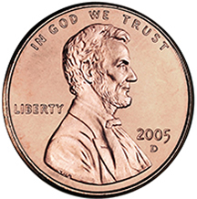
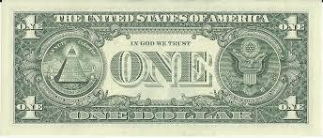
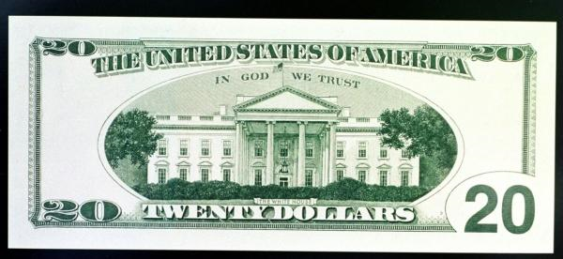
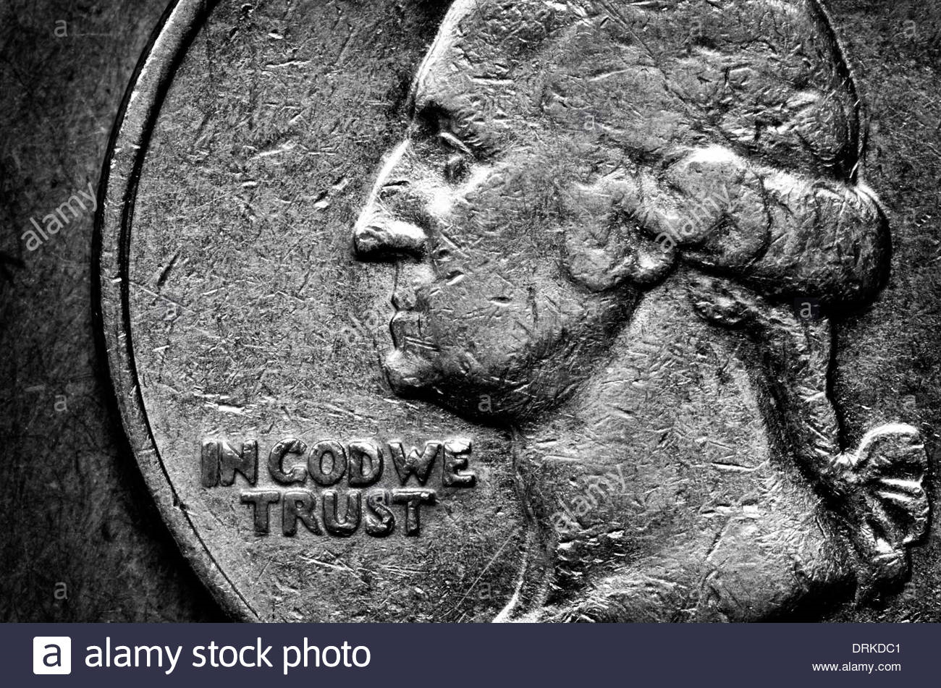
OWN IT! Symbols and Mottos
United States Currency: “In God we trust.”

Slide 12
OWN IT! Symbols and Mottos
Anti:

Slide 13
OWN IT! Symbols and Mottos
Peace:

Slide 14
OWN IT! Symbols and Mottos
Rosie the Riveter: “We can do it!”

Slide 15
OWN IT! Symbols and Mottos
United Farm Workers: “Si se puede.”

Slide 16
OWN IT! Symbols and Mottos
Medicine:

Slide 17
OWN IT! Symbols and Mottos
PlayStation: “Greatness awaits.”

